Slide 1
Data analysis

Slide 2
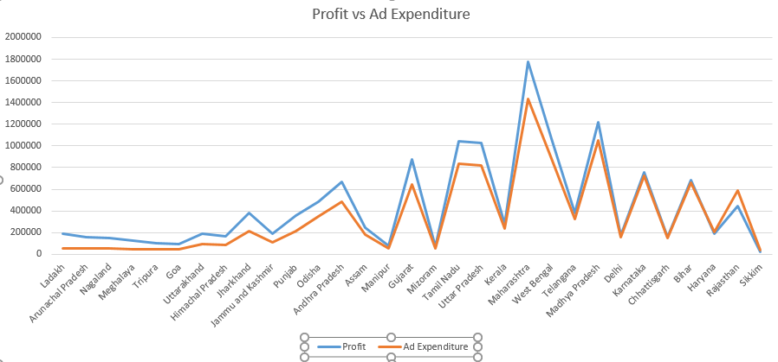
Haryana:
Profit:$190902
Ad expenditure:$206651
Sikkim:
Profit:$20133
Ad-expenditure:$36234
There are some states where the profit is less than the advertisement expenditure ( Haryana and Sikkim)
A possible suggestion is that in the state of Sikkim, despite low investment in In-Store costs, it’s yielding considerable revenue and thus further investments can be made in this sector along with investing more in the Online sector.
In Haryana’s case, investments made in in-store ads can be refocused more on In-store channel costs.

Slide 3
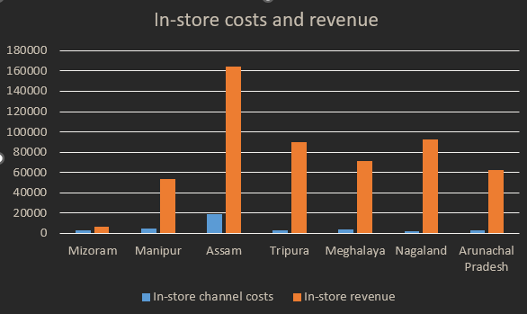
Upon inspection, most of the north-eastern states follow are trend where the in-store channel costs are low but yield comparatively high in-store revenue. As such more investment should be done on the in-store channel in order to increase the revenue in these states.

Slide 4
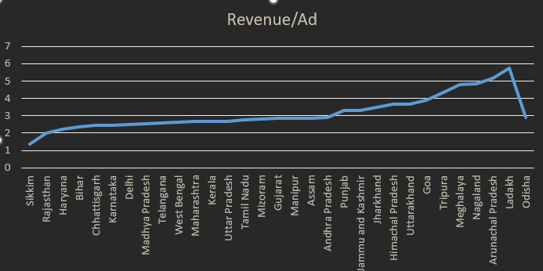
State:Ladakh
Rev/Expenditure: 5.770046257
Ladakh has the Rev/Expenditure ratio which shows that the current tactics are satisfactory though this also opens doors for further investments in this state.
Sikkim has the least Rev/Expenditure ratio. It’s in-store costs are high compared to the revenue it yields and thus more focus should be given into online channel costs.

Slide 5
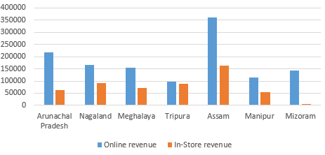
Some NE like Arunachal Pradesh, Assam and especially Mizoram where the difference between Online and In-store revenue is high.
In Assam, In-store channel costs can be reduced and be re focused on Online Channel Costs. The same can be said for Mizoram and Arunachal Pradesh as their in-store revenues are very low compared to the online ones as this is further contributed by the very less suitable geographical locations of the states.

Slide 6
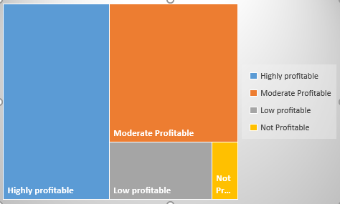
Segmentation and Classification
14 states
Avg profit:
$796263
Total profit:
$11147676
12 states
Avg profit:
$185515
Total profit:
$2226177
4 states
Total profit: $339307
Avg profit: $ 84827
1 state
Total profit:$20133
Avg profit:$20133
Out of customers from 30 states & UT compared, 14 of them are highly proifitable, 12 of them are moderate, 4 are where profit is comparatively low and 1 state is where profit is extremely low or none at all.

Slide 7
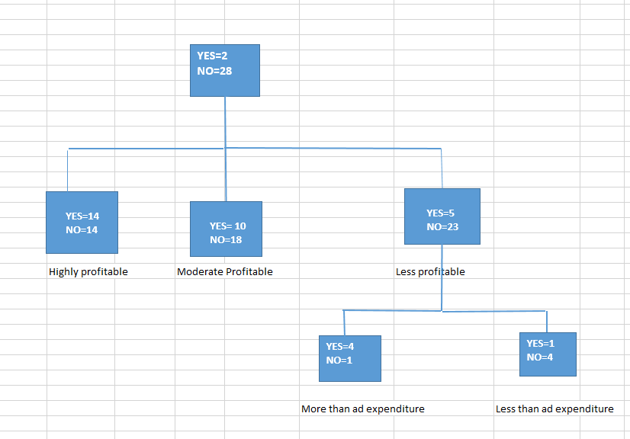
Segmentation and classification
1st phase:
Have more in-store channel expenditure than online
channel expenditure (2 states were filtered out and rest
28 were selected)
2nd phase:
Profit levels are checked
States with less profitability were checked
(23 were filtered out and rest 5 are selected)
A classification tree is done on which states have more cost requirements when compared to the profits they yield. Two states were filtered out in the 1st phase where online and in-store costs were checked.
After 3 phases, 1 state is shown to have the maximum problems that is Sikkim where the attention of the marketing team should be focused when compared to the other states.
3rd phase:
Profit vs Ad expenditure checked
(4 were filtered out and 1 was selected)

Slide 8
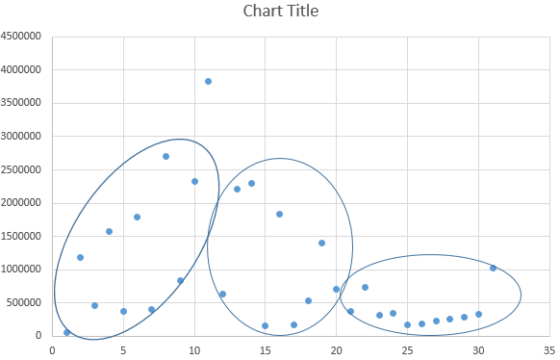
Highest revenue:$3830967
State : Maharashtra
Cluster-1
Upper limit: $1891317
Average= $956493.8387
S. Deviation=$934823.9008
Lower limit: $21670
Lowest revenue:$48660
State : Sikkim
Cluster-2
3 clusters are formed from the Total revenue graph. Majority of the states yield less than the average revenue
Maharashtra yields the highest revenue of $3830967 while Sikkim yields the lowest of $48660
The average is $956493.8387 and S . Deviation is $934823.9008
Cluster-3

Slide 9
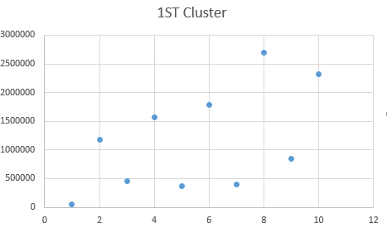
Upperlimit:$2068113.6
Average:$1167498
SD: $900615.6
Lowerlimit:$266822.4
State:Sikkim
Revenue: $48660
In the first cluster, majority of the revenue obtained from different states lie between the upperlimit:$2068113.6 and Lowerlimit:$266822.4 and the average revenue is $1167498. The SD of the cluster is $900615.6
Investement should be done on the states that are below the lower limit that is Sikkim

Slide 10
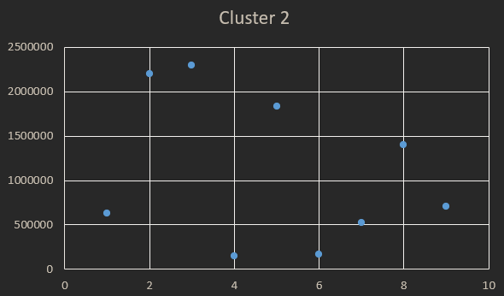
Upperlimit:$1949379
Average:$1101178
SD:$848201.6
Lowerlimit:$252976.4
State:Mizoram
Revenue:$ 149337
State:Manipur
Revenue:$ 166661
In the first cluster, majority of the revenue obtained from different states lie between the upperlimit:$ 1949379 and Lowerlimit:$ 252976.4 and the average revenue is $1101178
.The SD of the cluster is $848201.6
Investment can be refocused from the states that are above the upper limit (Gujarat and Andhra Pradesh) to states whose revenue are below the lower limit(Mizoram and Manipur)

Slide 11
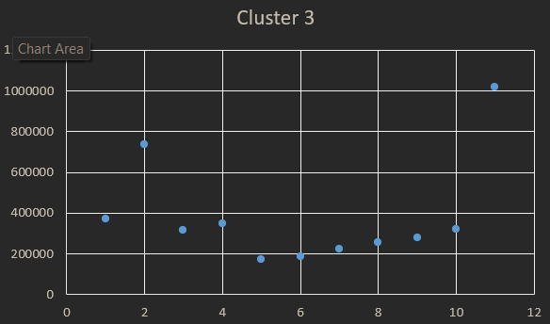
Upperlimit:$644242.5
Average:$384978.5
SD:$259264
Lowerlimit:$125714.5
In the first cluster, majority of the revenue obtained from different states lie between the upperlimit:$ 644242.5 and Lowerlimit:$ 125714.5 and the average revenue is $1167498. The SD of the cluster is $900615.6
None of the states are below the lower limit.

